Slide 1


Tele-LLMs: Large Language Models for Telecom
Ali Maatouk

Slide 2
Introduction

Slide 3
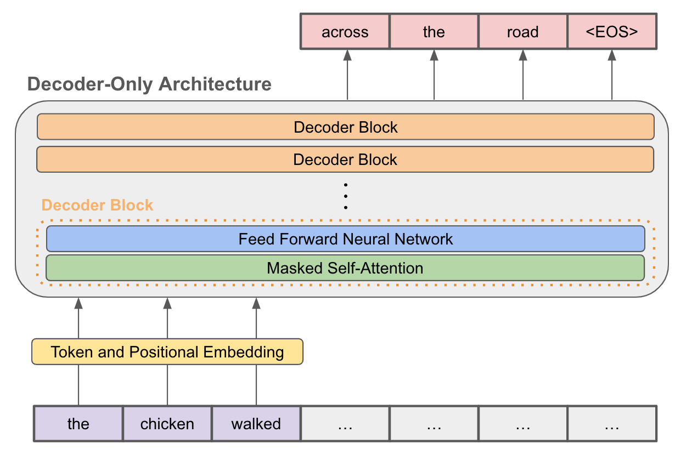
Large Language Models
Deep learning models typically based on the Transformers architecture
Pre-trained on a large corpus of data with next-token prediction objective
Revolutionized NLP applications such as machine translation and sentiment analysis
Its effect is being witnessed across many other fields such as medicine¹, finance², and law³
[1] Zheng et al., “Large Language Models for Medicine: A Survey”, arxiv preprint 2405.13055, 2024
[2] Lee et al., "A Survey of Large Language Models in Finance (FinLLMs)”, arxiv preprint 2402.02315, 2024
[3] Lai et al., "Large Language Models in Law: A Survey”, arxiv preprint 2312.03718, 2023

Slide 4
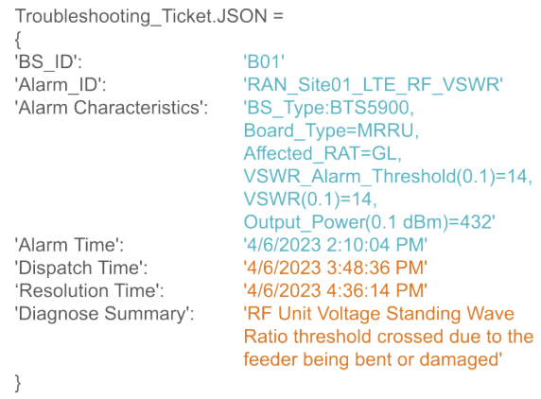
Applications for Telecom
LLMs are expected to be leveraged in both short-term and long-term telecommunications applications
Anomalies resolutions⁴
Provide engineers with interactive tool to help facilitates network faults resolution
Chatbots
Standards, scholarly material, or product manuals
Telecom agents
Granular LLM-based tools that can aid in network operation, e.g., intents to configuration files translations⁵
[4] Maatouk et al., "Large Language Models for Telecom: Forthcoming Impact on the Industry," in IEEE Communications Magazine, 2024
[5] Briah et al., “Large Generative AI Models for Telecom: The Next Big Thing?”, arxiv pre-print 2306.10249, 2023
Notes:
- The troubleshooting ticket is an example in telecommunications where engineer provide such textual data after intervening to repair a cellular tower for example
LLMs will be able to help these anomalies resolution by providing engineers with an interactive tool that facilitates network faults resolution and root cause analysis
Providing engineers with a chatbot to discuss standards, scholarly material, or product manuals

Slide 5
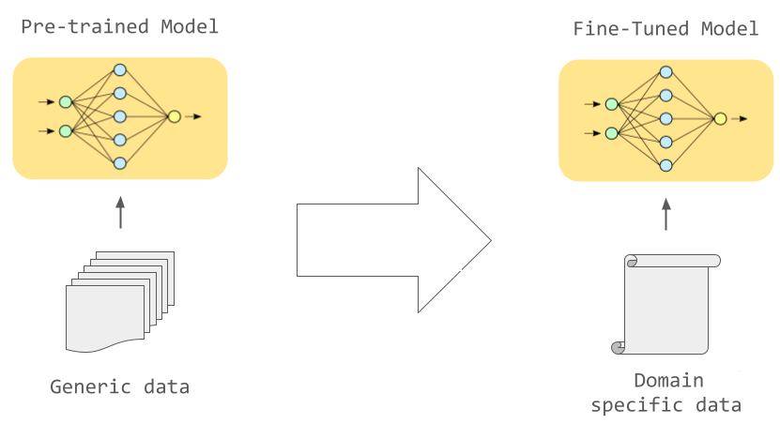

Domain Adaptation
Adapting LLMs to the telecom domain can be done in two ways
Training from scratch on telecommunications material
Drawback: Miss out on the abilities that LLMs can learn and transfer from other sources
Calibrate an already pre-trained model through continual pre-training
Steps to be taken
Gather telecom-related data
Ensure their cleanliness
Creating an evaluation framework
Develop well-performing training settings
Notes:
- Transferable abilities include: language, grammar, coding, etc.
Good training settings involve:
- Proper learning rate schedules, (re)-warming of the model, and other training parameters that fits most the behavior of the LLM when it comes to telecom data

Slide 6
Datasets

Slide 7



Telecommunications Data
The main telecommunications data we consider are open-access material
Scholarly material
Open-source papers (e.g., arXiv)
Standards
3GPP documents (NR, LTE, etc.)
Websites
Wikipedia articles
Telecom-related forums
Google patents
Common crawl dumps for further filtering

Slide 8
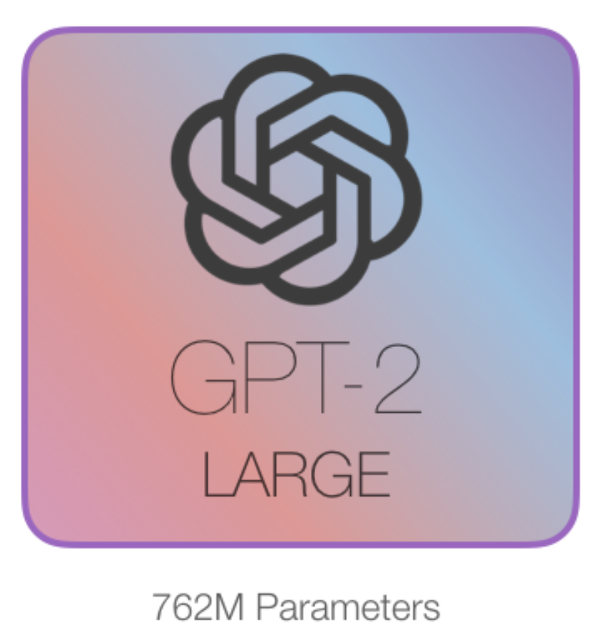
Academic Papers
Extensive cleaning & structuring of arXiv papers is carried out
Find papers related telecom through LLM-based classification
LaTeX projects flattening, removal of comments, replacing user-defined macros, deleting commonly used latex commands, etc.
Evaluate how clean the resulting dataset is through cross-entropy loss
We compare the 10% of hardest tokens of clean and raw papers
We leverage a language model not trained on arXiv
Example: GPT-2 Large
Notes:
- Perhaps to motivate why we don’t take processed pdfs datasets such as S2ORC by semantic scholar: They lack the equations information critical for telecommunications
At the same time, LaTeX sources of arXiv are extremely noisy, and for this reason we do a lot of cleaning
The LLM-based classification prompt is the following:
Given the following scientific paper abstract: {Abstract}, Answer by Yes or No if this paper is related to the telecommunications and networking domains.
The cross entropy loss is then used to see how hard for GPT-2 (not trained on arxiv) to estimate the tokens in the dataset

Slide 9
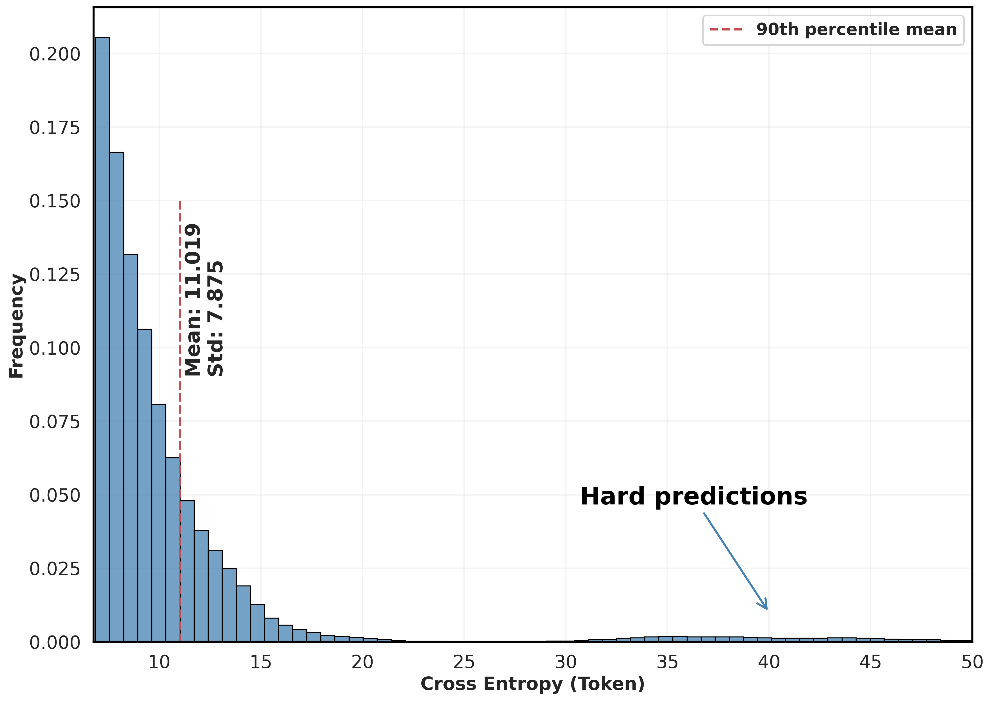
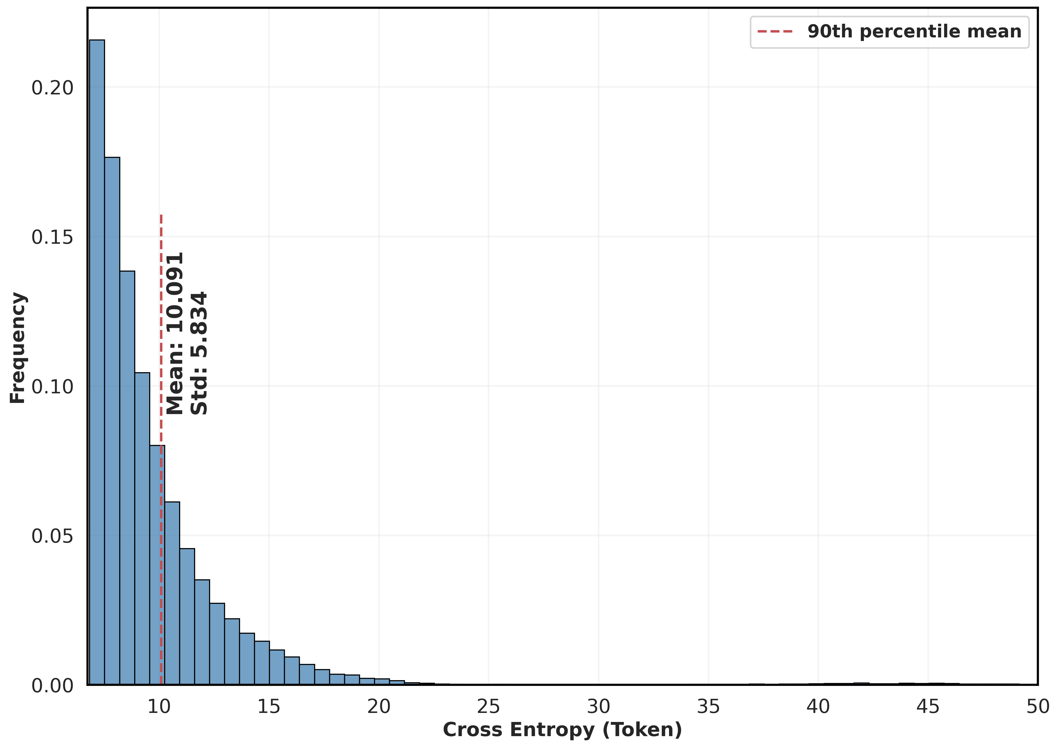
Cleanliness Comparison
Raw (left) versus clean (right) papers
Results: lower mean and smaller standard deviation for the 90th percentile cross entropy

Slide 10




Remaining Material
Standards
FTP server to download the word documents
Cleaning & structuring:
Removal of references, appendices, figures, and other non-critical information
Creating a pipeline of LaTeX transformation to ensure equations are preserved
Websites
Filter common crawl dumps for telecom material (forums, online discussions, etc.)
Notes:
We do standards transformation to Latex cause equations are very important in standards:
1) A lot of how standards work are in these equations
2) It also create a unification with the arXiv dataset
To filter websites, we used a combination of:
url matching (to get specific websites of interest),
Keywords regex (if any of our developed 100 keywords related to telecom are matched)
Finally, an LLM-based filtering that make sure

Slide 11
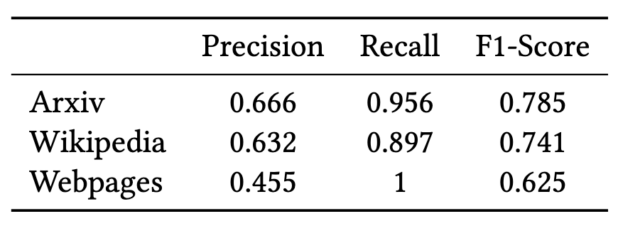
Final Dataset
Filtering results
High recall: rarely miss telecom material
Lower precision: Difficulty to discern technical contents or similar topics to telecommunications
Material | Entries | Tokens
Wikipedia | 19k | 26M
Standards | 2.8k | 70M
Papers | 90k | 1.05B
Web | 740k | 1.35B
Total: approximately 2.5B tokens
Notes:
The recall is super high for the LLM-based classification to see if an item is related to telecom or not
The precision is lower because sometimes it includes topics that are similar to telecom (e.g., computing) or not able to discern technical telecommunications content from content related to for example stories about Verizon, AT&T and stuff like that (for the case of wiki and webpages)

Slide 12
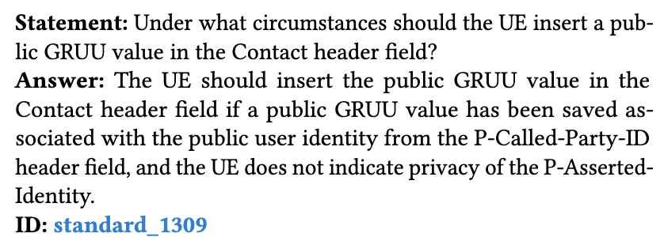
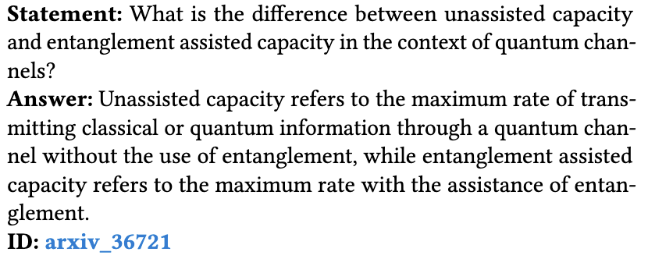
Evaluation Dataset
Create a dataset that verify several conditions
Open-ended questions
Granular (i.e., revolve around small concept in the material)
Mapped with all IDs of the material for sub-domain adaptation
LLM-based generation, with both regex and LLM-based filtering (750k QnAs)
Notes:
After domain adaptation, we need to evaluate the model
Ideally, downstreams tasks are used for such evaluation. However, no such unifications of tasks exist for the telecom domain yet
QnA can be taken as a surrogate to test this knowledge (similar to what is done in other AI tasks such as MMLU, etc.)
Existing telecom QnA dataset are MCQ (e.g., TeleQnA⁷)
LLMs are not robust MCQ selectors due to their inherent selection bias⁸
[7] https://github.com/netop-team/TeleQnA
[8] Zheng et al. “Large Language Models Are Not Robust Multiple Choice Selectors”, ICLR 2024
The regex filtering involve removing questions that has references such as “in this context”, “in this paper”, and any other local references to the segment from which the question was generated

Slide 13
Initial Exploration

Slide 14
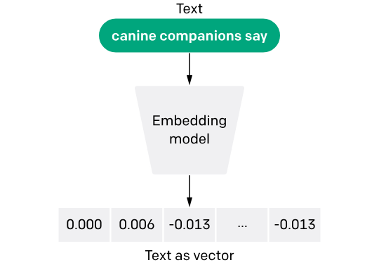

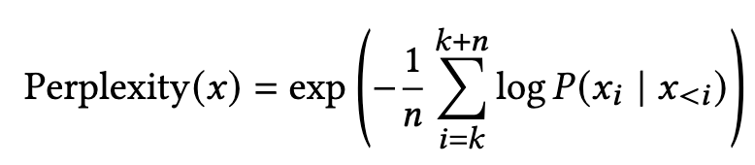
Evaluation Metrics
SemScore
Cosine similarity between the embedding of both the ground truth x and the generated answer y (e.g., BERT embeddings)
Ans-PPL
Conditioned on the question string ending at x_{k}, evaluate how “surprised” the model is by the answer from k to k+n
LLM-Eval
Provide both the ground truth and generated answer to an LLM
Prompt the model to judge if the generated answer is correct
Catastrophic forgetting
Finetuning may lose already acquired abilities of the model
Evaluate this effect using datasets such as MMLU, HellaSWAG, GSM8K
Notes:
Prompt of the LLM for LLM-Eval
””””
Task: Evaluate the correctness of a provided answer to a telecommunications and networking question.
Question: {questions[j]}
Ground Truth Answer: {references[j]}
Provided Answer: {predictions[j]}
Instructions:
1. Compare the Provided Answer to the Ground Truth Answer.
2. Determine if the Provided Answer is correct based on the Ground Truth Answer.
3. Respond with only Yes or No.
Is the Provided Answer correct?
“””””

Slide 15
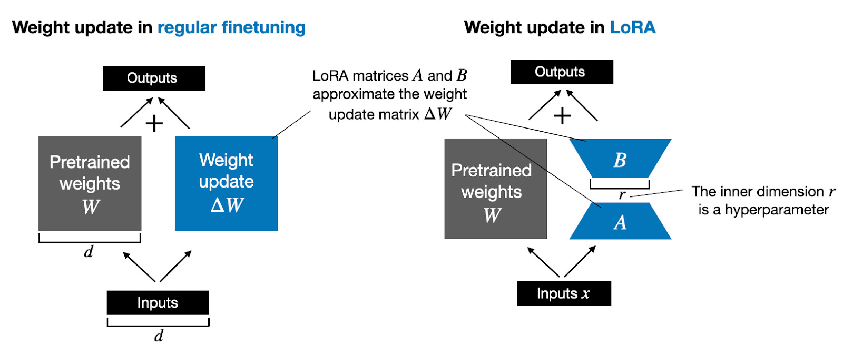
FFT vs PEFT
Parameters efficient fine-tuning presents itself as an alternative to full parameters finetuning
Less memory and compute requirements
Low rank maneuvering in the loss landscape

Slide 16
LoRa to the Rescue?
20% of the dataset as training with 10% of it set as validation
Gemma 2B (top) versus Llama-3-8B (bottom)
LoRa can inject knowledge in smaller models to some extent but fail for larger models
Small gradient norm due to their proficiency with telecom (more aggressive updating needed!)
Notes:
The lora rank was taken as r=32 and lora_alpha=64
The learning rate is taken a bit higher for the smaller model, a common practice given the sensitivity of bigger models to any changes

Slide 17
Number of Epochs
Smaller models saturate even with multiple epochs
Bigger models exhibit memorization of training patterns due to their expressiveness
Maximum 2 epochs of training for all these models
Notes:
The lora rank was taken as r=32 and lora_alpha=64
The learning rate is taken a bit higher for the smaller model, a common practice given the sensitivity of bigger models to any changes

Slide 18
Tele-LLMs

Slide 19
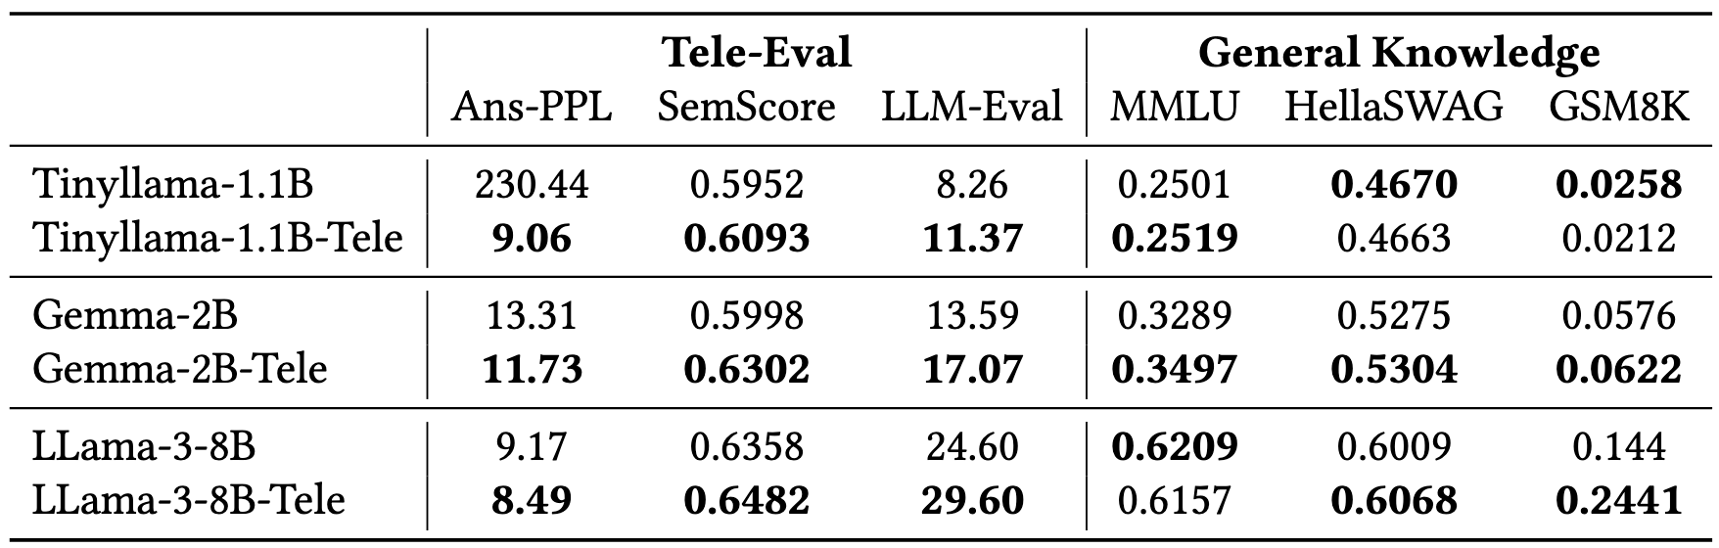
Open-Source Models
We have trained the first open-source models specialized in telecommunications
LLM-Eval is the most robust but most expensive metric
Tele-LLMs outperform on telecom while retaining (or even gaining) performance on general abilities
Notes:
The lora rank was taken as r=32 and lora_alpha=64
The learning rate is taken a bit higher for the smaller model, a common practice given the sensitivity of bigger models to any changes

Slide 20
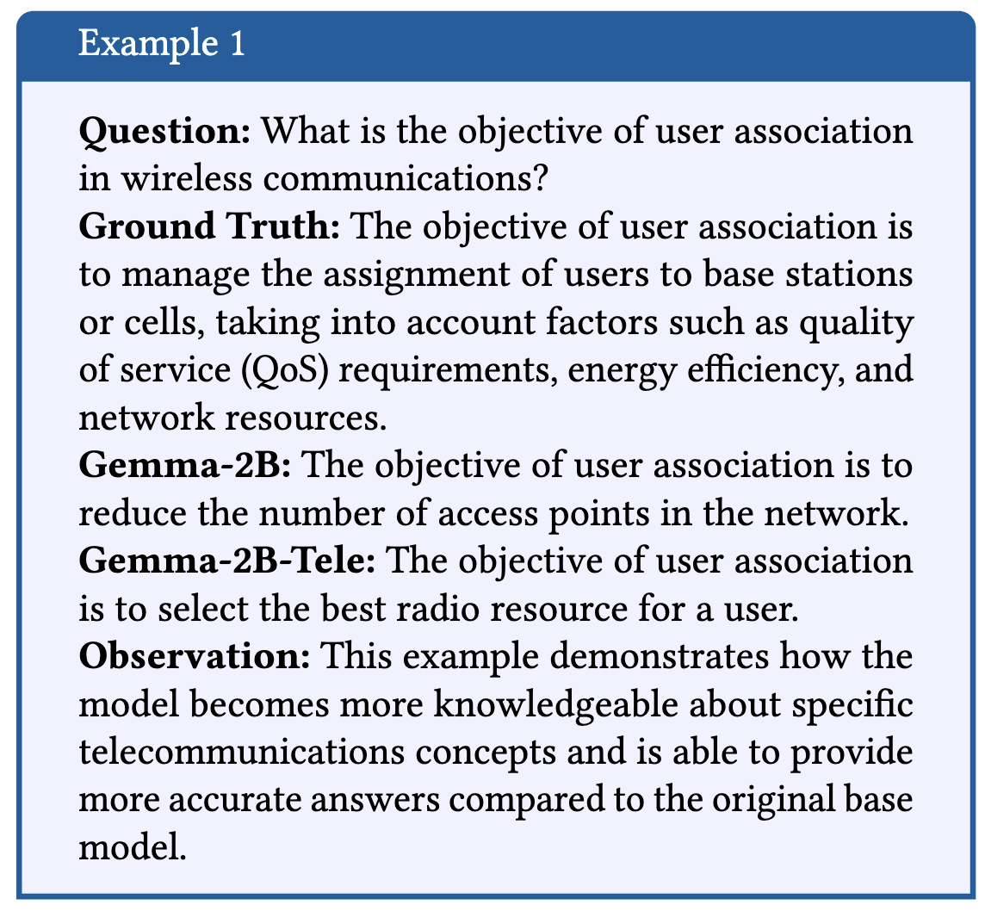
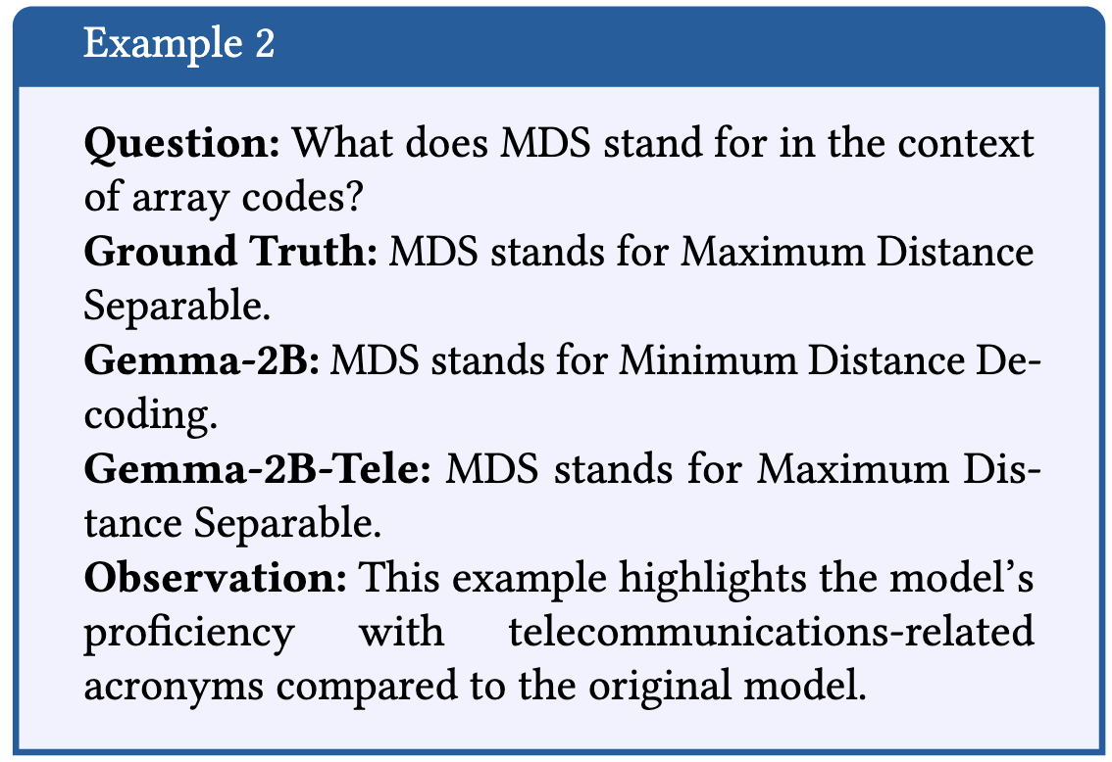
Qualitative Examples – Part 1
Notes:
Most of the responses, the trained model goes really into technical details and so on compared to the original model. It is more confident, daring, and more willing to generate details compared to the base model

Slide 21
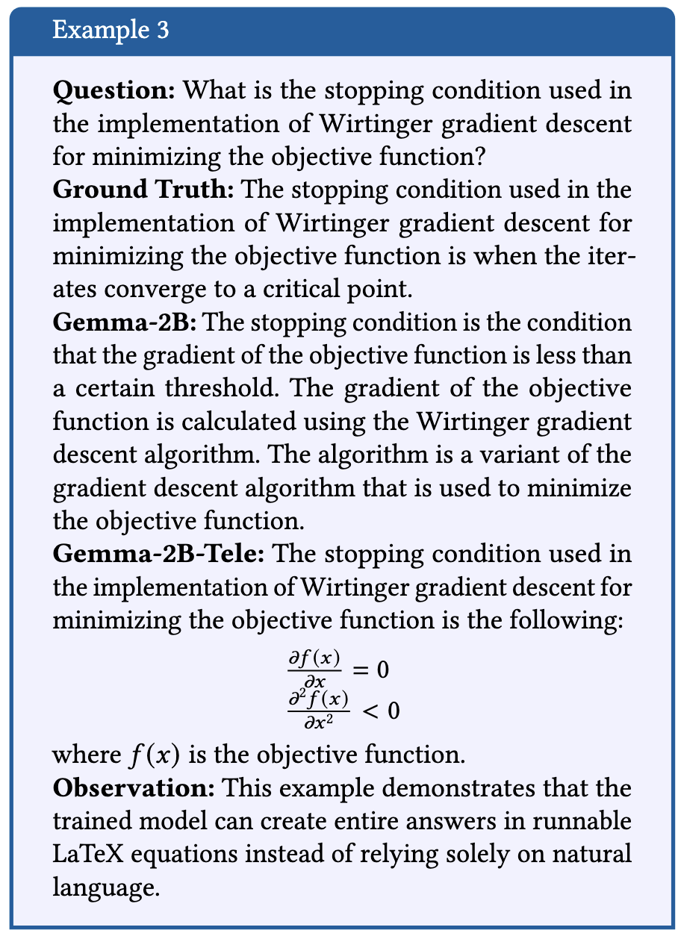
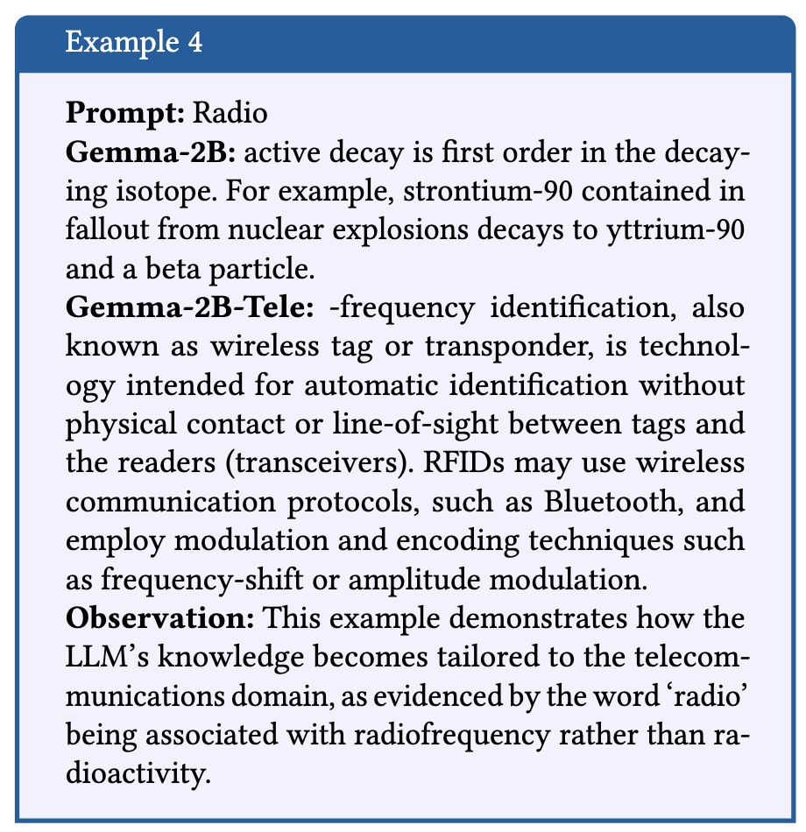
Qualitative Examples – Part 2
Notes:
Most of the responses, the trained model goes really into technical details and so on compared to the original model. It is more confident, daring, and more willing to generate details compared to the base model

Slide 22
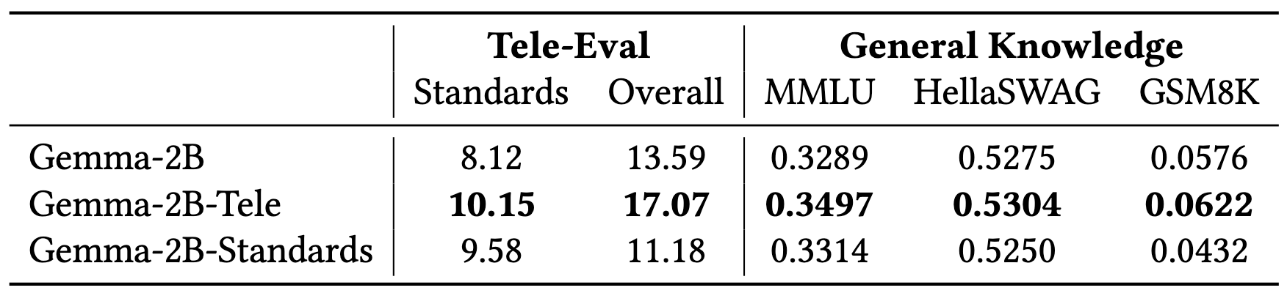
Division of Expertise
Question: Should we train multiple models on different aspects of telecommunications?
We answer this question using the 3GPP standards separation
Transfer learning is key!
More data related to telecom is always better
Notes:
The lora rank was taken as r=32 and lora_alpha=64
The learning rate is taken a bit higher for the smaller model, a common practice given the sensitivity of bigger models to any changes

Slide 23
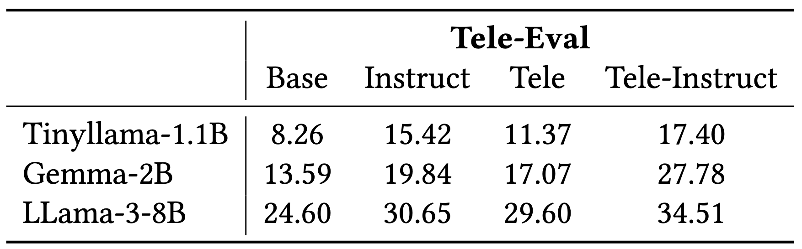
Instruct Models
Base models are most fit for finetuning to telecom applications
For interactive use, we need instruct models
Instruct models can follow instructions and answer queries
Created an instruct model of the adapted models by finetuning on Alpaca and OpenHermes instruct datasets
Our instruct models outperform current models on telecommunications knowledge
Notes:
The lora rank was taken as r=32 and lora_alpha=64
The learning rate is taken a bit higher for the smaller model, a common practice given the sensitivity of bigger models to any changes

Slide 24


Thank you!

